Slide 1
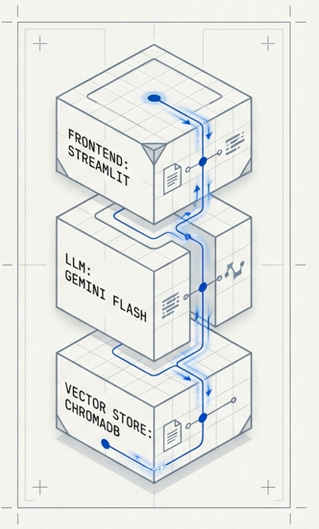
UPBC CHATBOT:
Technical Data Engine
High-Performance RAG & Architecture & Data Structure Optimization
Core Stack: Gemini Flash, ChromaDB, LangChain
Scope: Institutional Data Navigation Regulatory Retrieval
Type: Hybrid System Vector Space Engineering
Team: 6
Elia Ivette Cota Rivera, Jesús Guillermo Arroyo Navarro, María Ysabel Márquez Montenegro

Slide 2
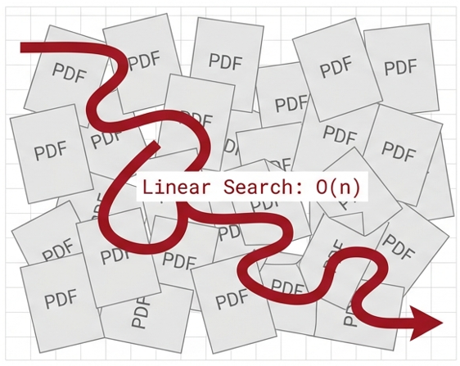
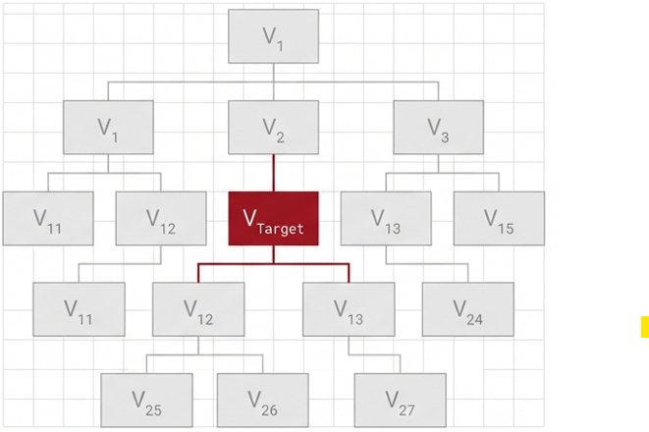
Problem definition: The Linear Search Trap
The bottleneck: Unstructured data
The goal: Structure vectors
Standard LLMs guess context.
Hig computational cost at scale
Sub-second context retrieval
Hierarchical, high-dimensional indexing

Slide 3
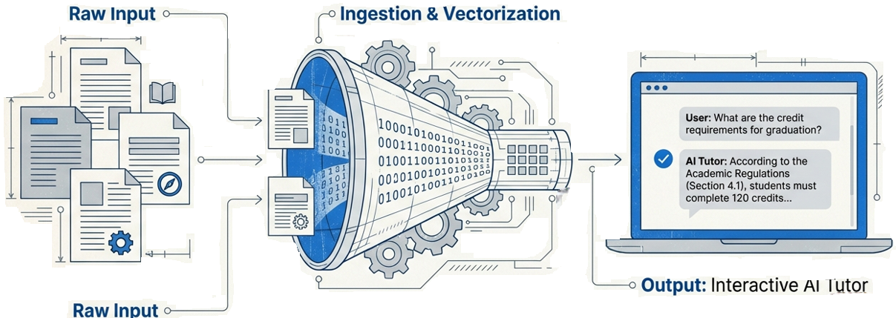
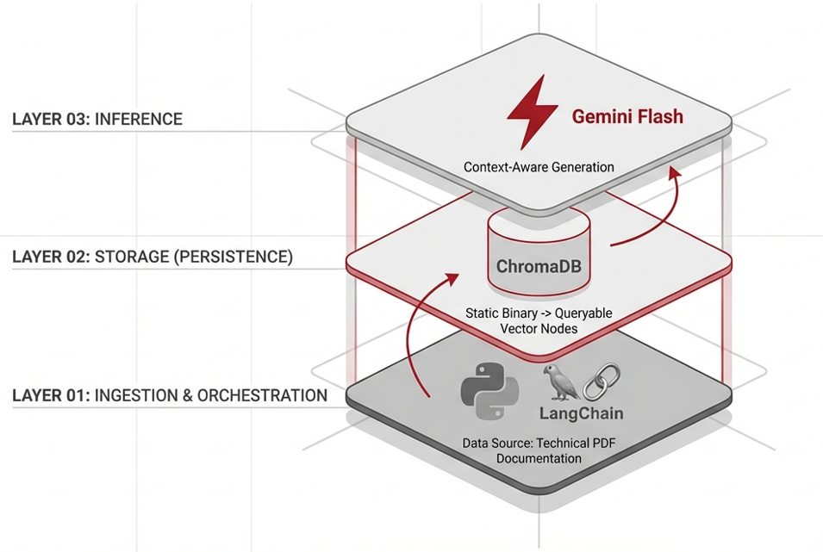
Solution Architecture: Hybrid Retrieval
Objective: Test efficiency of 0(log n) search patterns in technical domain

Slide 4
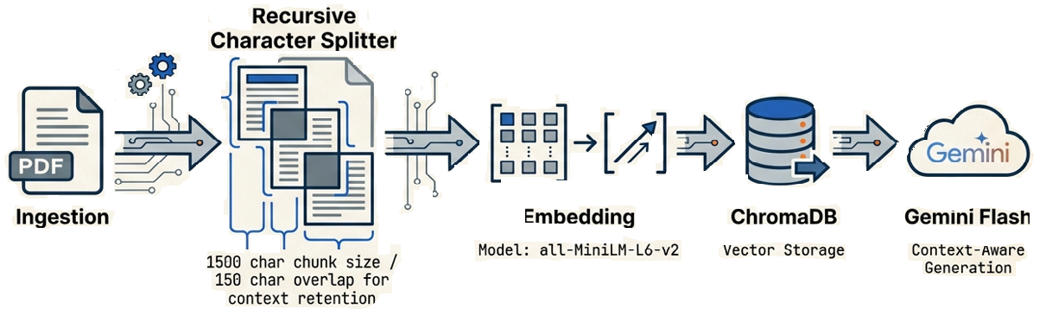


System architecture & data flow

Slide 5
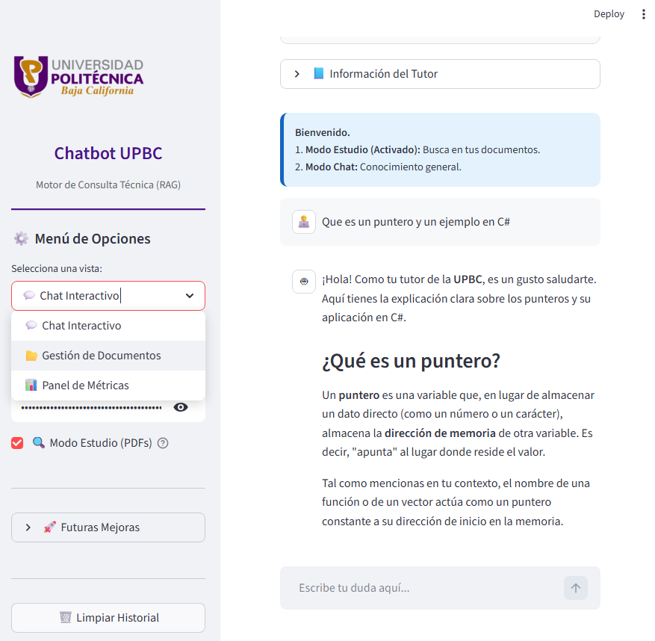
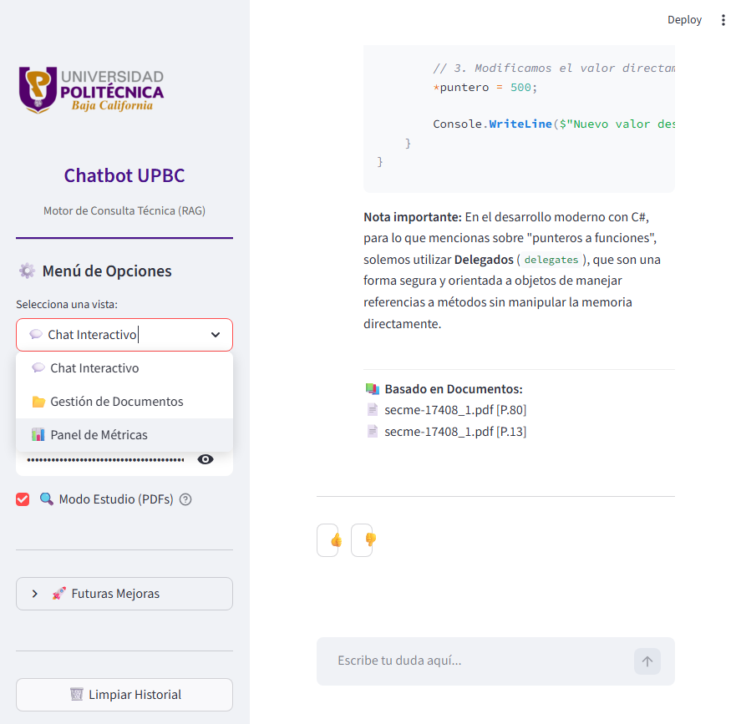
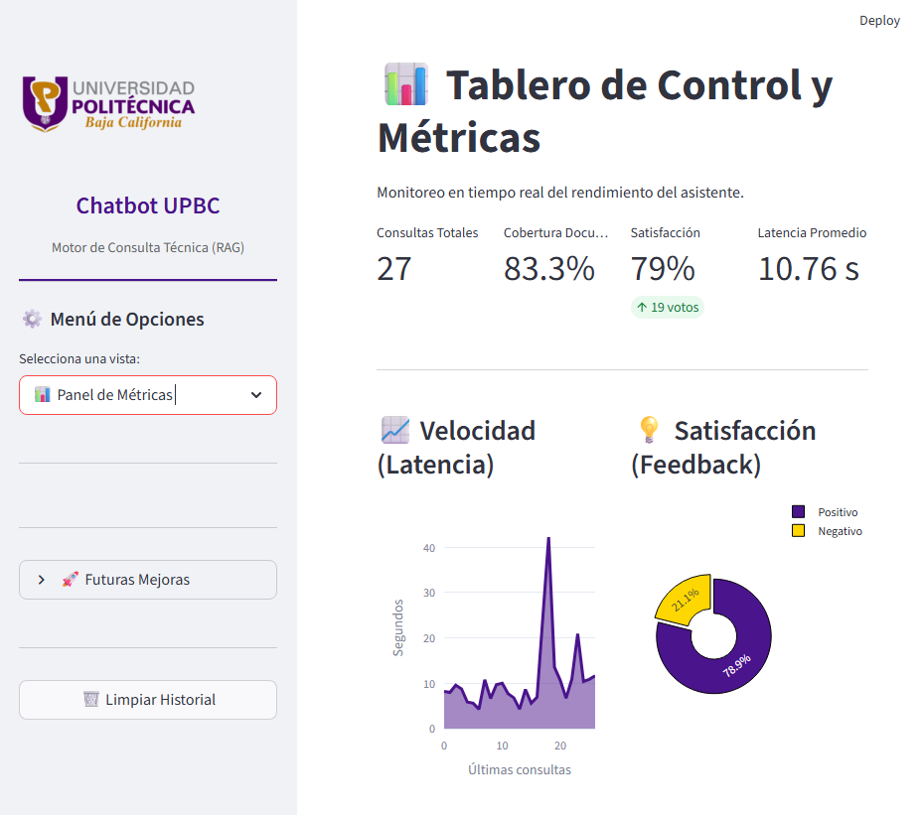
System capability demo

Slide 6
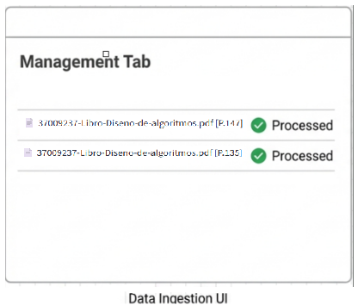
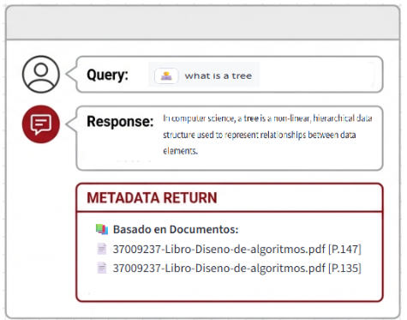
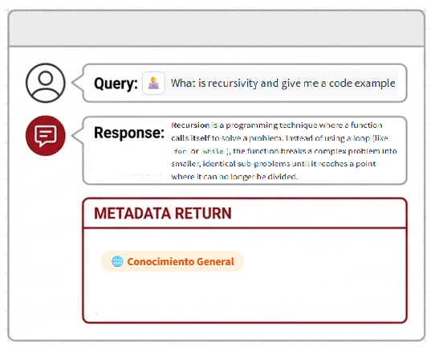
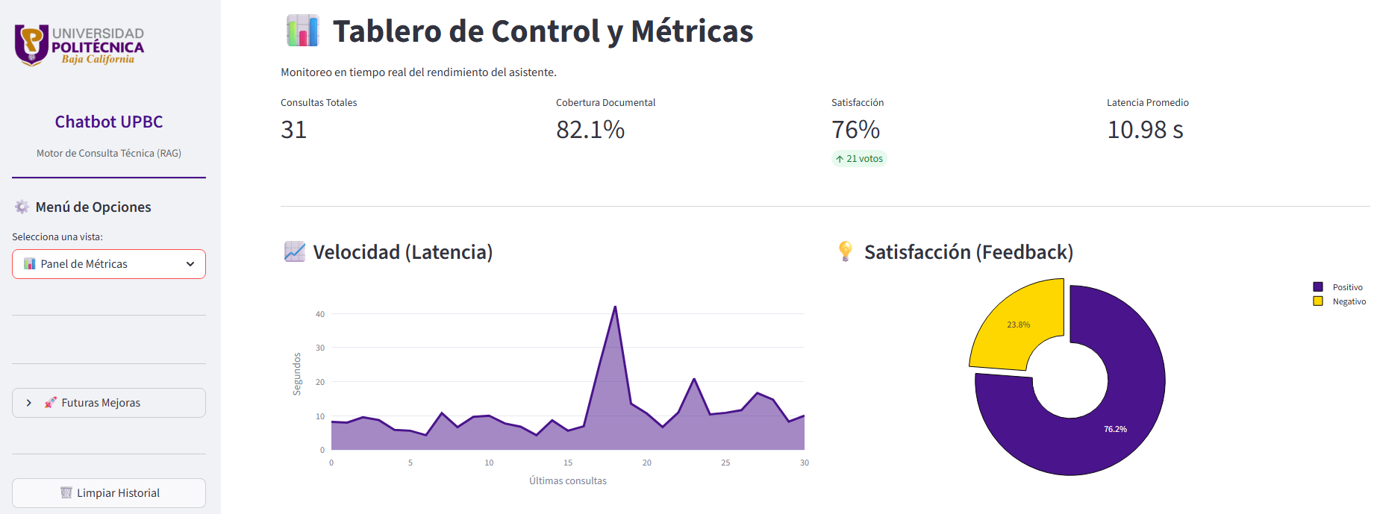
Performance & Metrics & Validation

Slide 7
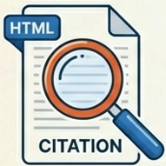


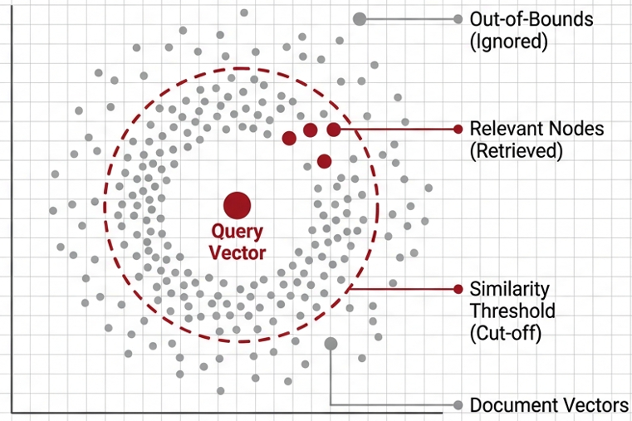
ENGINEERING WINS: WHAT WORKED
SOURCE ATTRIBUTION
The HTML badge system for page-specific citations worked flawlessly.
It builds immediate user trust by allowing verification of AI’s answers against the official PDF.
HYBRID RETRIEVAL
Balanced specific document search with general chat capabilities. The system can recite a rule verbatim OR synthesize a summary depending on the user’s need.
PERFORMANCE OPTIMIZATION
Caching vector store connections significantly reduced latency. The “real-time” is essential for student engagement.
HALLUCINATIONS CONTROL: VECTOR DISTANCE
FILTERING LOGIC
Calculate Cosine similarity
If distance > Threshold, reject query
Result: System refuses to answer off-topic prompts

Slide 8

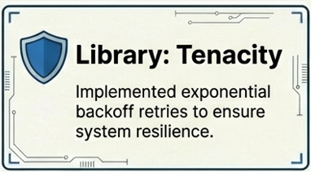

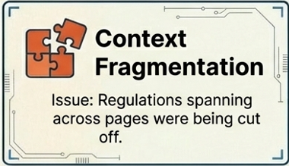
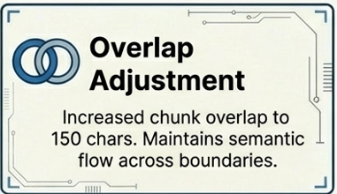
Challenges & technical solution
Transparency note: The 25% failure rate primarily occurs with very short or ambitious queries lacking sufficient keywords for vector retrieval

Slide 9
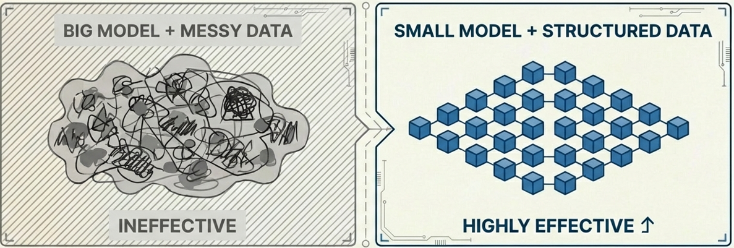



STRATEGIC INSIGHTS & KEY LEARNING
PROMPTS ARE CODE:
Defining a clear persona (The expert tutor) is as critical as the Python backend
STRUCTURE > SIZE:
A well-chunked dataset yields better results than a generic “smart” LLM
EFFICIENCY:
The small “all-MiniLM-L6-v2” model handled technical Spanish terminology surprisingly well

Slide 10
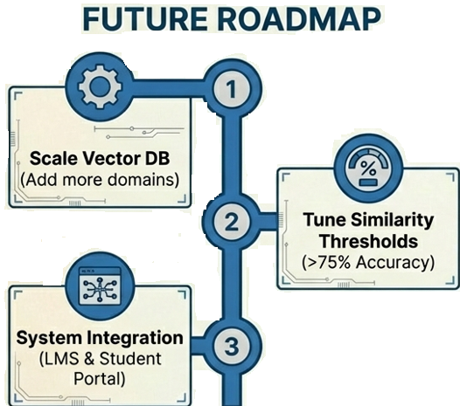




ROADMAP & TECHNICAL DISCUSSION
Scaling vector storage for 1000 + documents
Handling ambiguous user queries
Strategies for PDF table extraction

